Slide 1

Capstone Project
Application Infrastructure Development on Cloud

Slide 2
Introduction
Whiteboard Jr. is a software organization that provides application solutions for several organizations. Due to issues in managing the large infrastructure and rising costs, the company has decided to move its infrastructure to the cloud.

Slide 3
PROJECT OBJECTIVE
The network should have zero downtime for mission-critical or necessary applications and 99% availability for other applications.
Critical systems should have backups or snapshots stored in highly available and fault tolerant storages.
An isolated network should be provided for the WordPress application and database server using VPCs and security groups.

Slide 4
AGENDA
Design
IAM Solution
Setup VPC
Application and instance fleet
Automation using Ansible
Monitoring Solutions

Slide 5
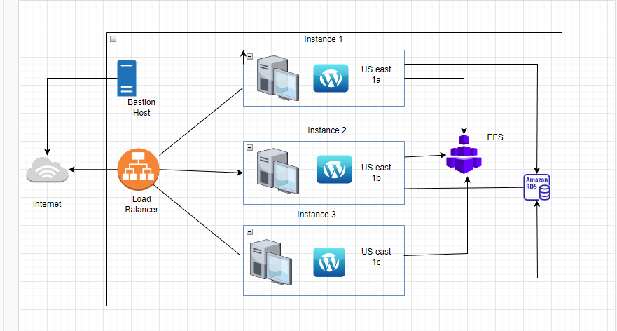
Design

Slide 6
IAM service
IAM is one of Global service of AWS and it is used to manage authentication and authorization.
It also used to create User , Roles , Policy.
We can also add two-factor authentication to user accounts and to individual users for extra security.

Slide 7
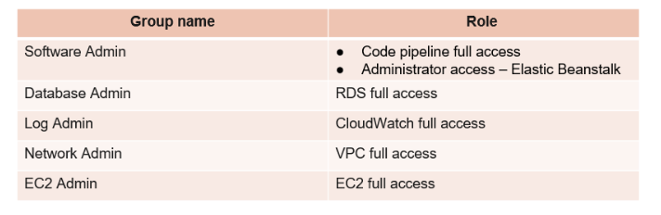
Group and Roles

Slide 8
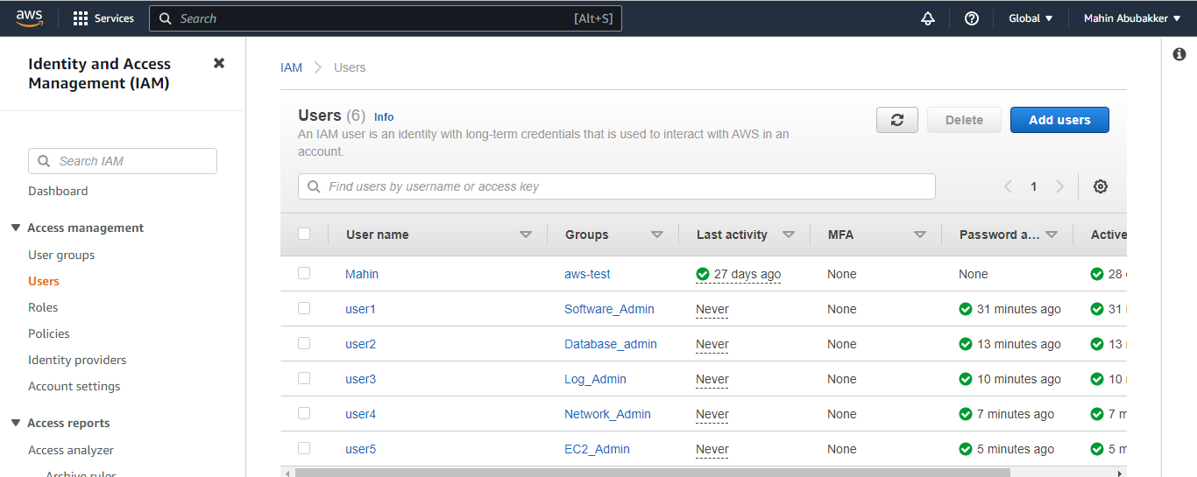
Adding I AM Users

Slide 9
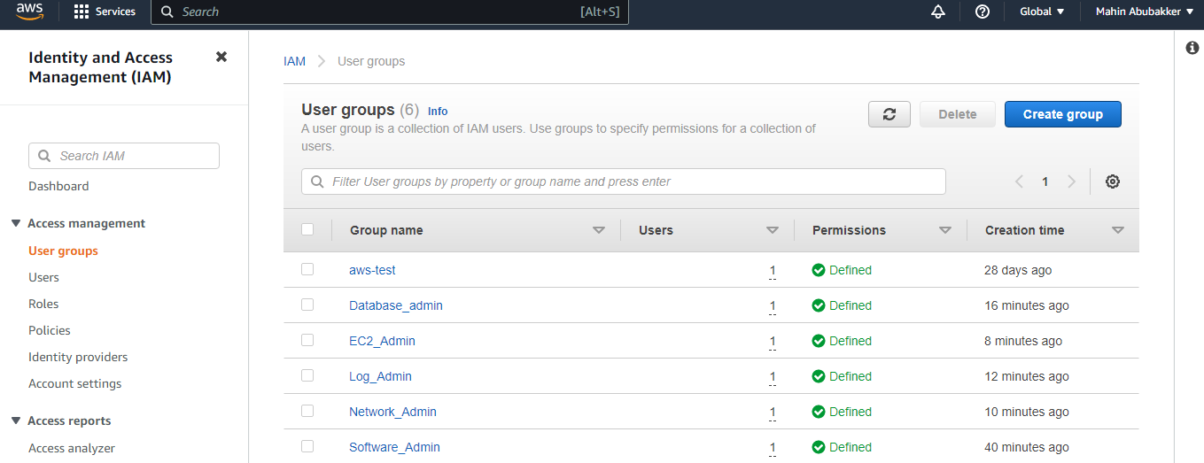
Creating I AM Groups

Slide 10
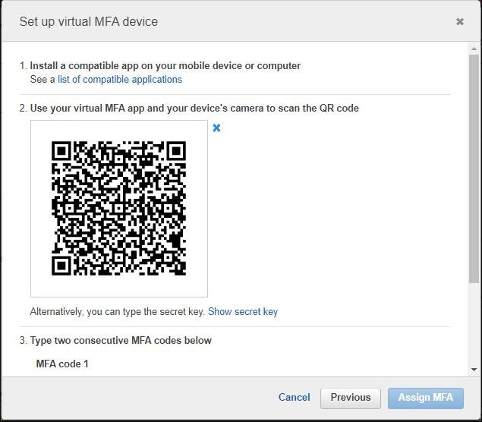
MFA

Slide 11
VPC
VPC is an isolated sections of a public cloud in order to provide a virtual private environment.
In Amazon VPC You can specify an IP address range for the VPC, add subnets, add routes, add gateways, and associate security groups.

Slide 12
VPC Objectives
VPC
Subnets
Route table
Internet Gateway
NAT Gateway
Security Group

Slide 13
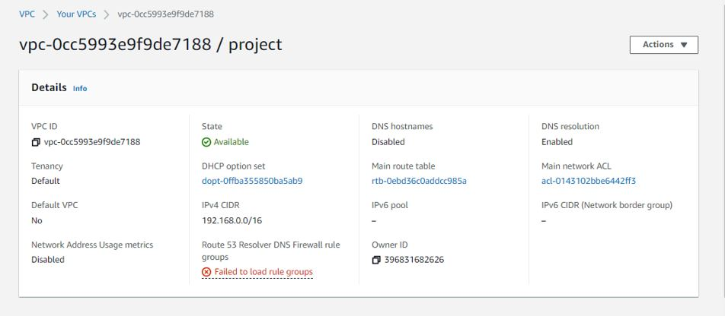
Creating VPC

Slide 14
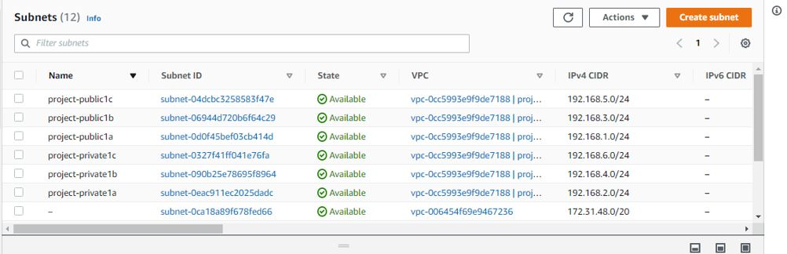
Creating Subnets

Slide 15
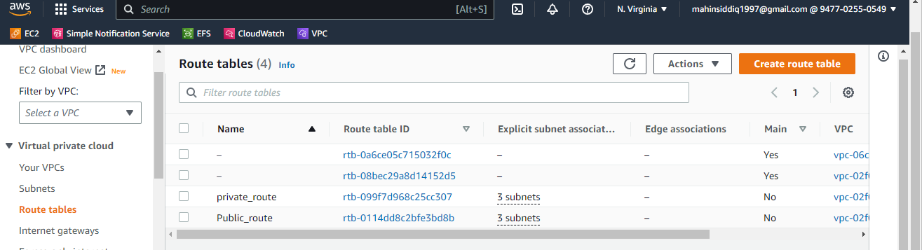
Route table

Slide 16
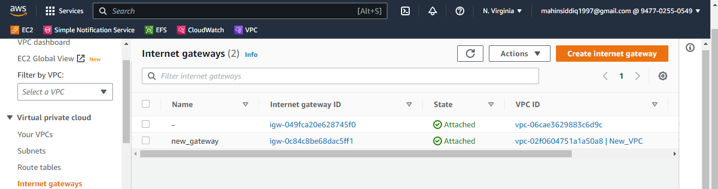
Internet Gateway

Slide 17
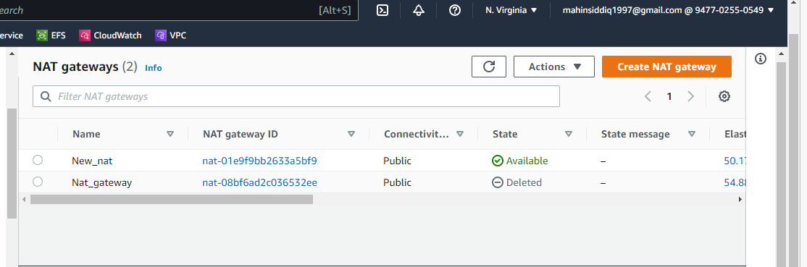
NAT Gateway

Slide 18
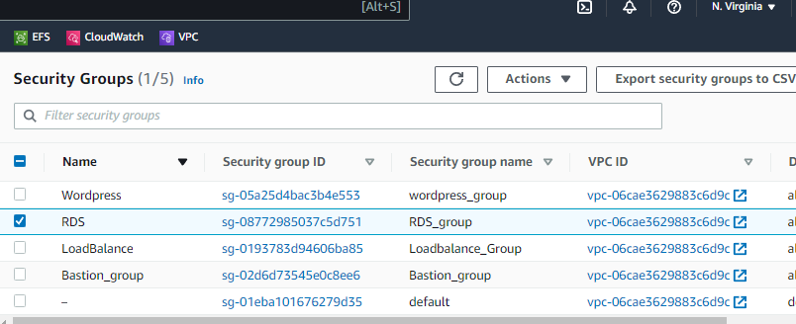
Security Groups

Slide 19
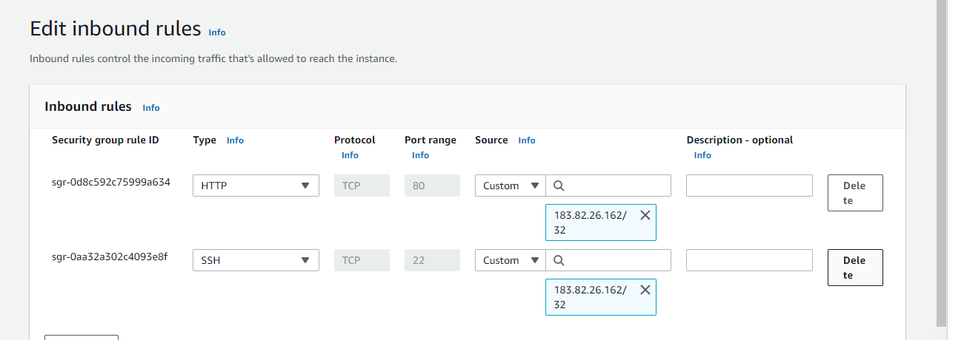
Bastion Host Security Group

Slide 20
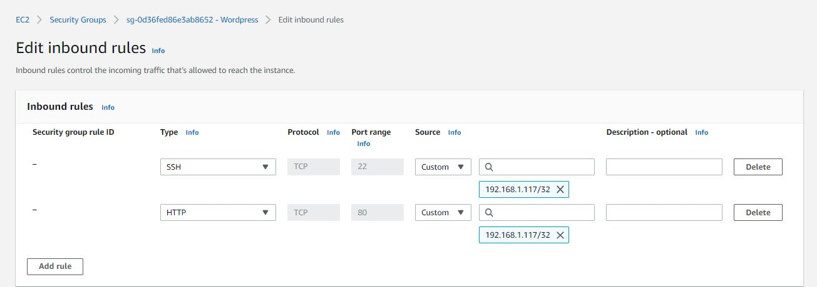
WordPress Instance Security Group

Slide 21
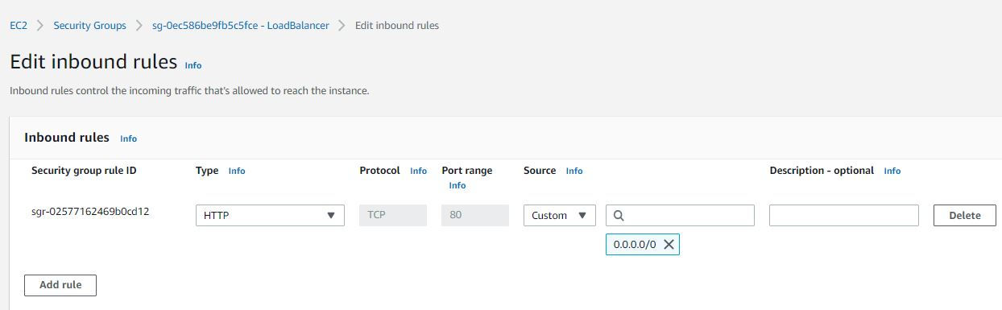
Load Balancer Security Group

Slide 22
Implement Application and Instance Fleets

Slide 23
Tasks
Configure Amazon Relational Database Service (Amazon RDS)
Install Wordpress
Configure Load Balancer
Configure Amazon Elastic File System (EFS)
Create a snapshot
Create Auto Scaling

Slide 24
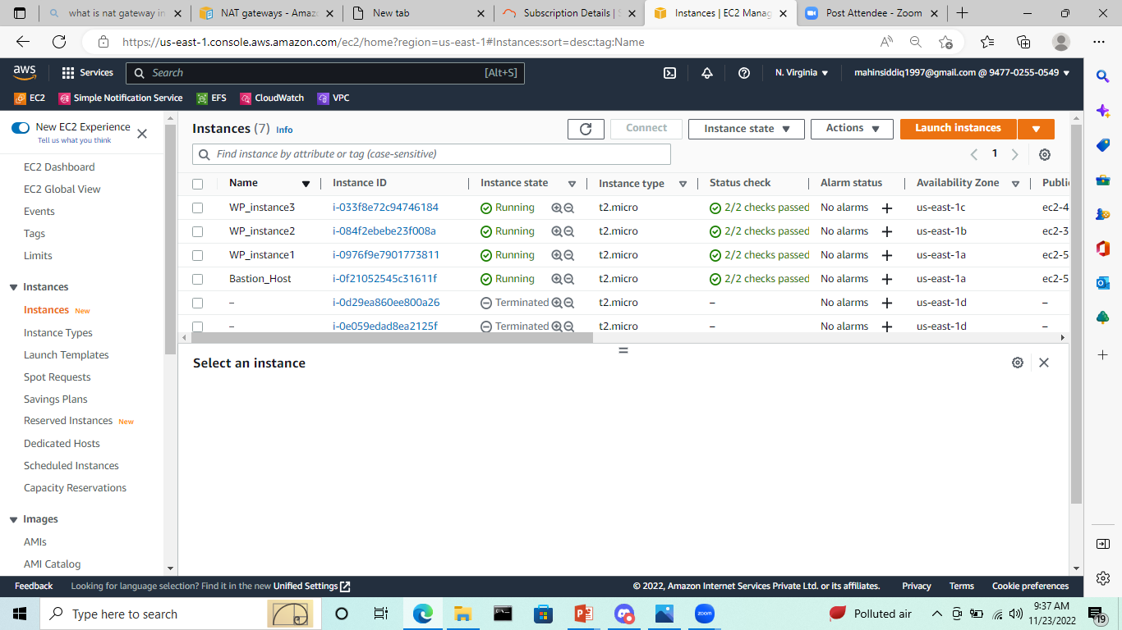
Creating Instances

Slide 25
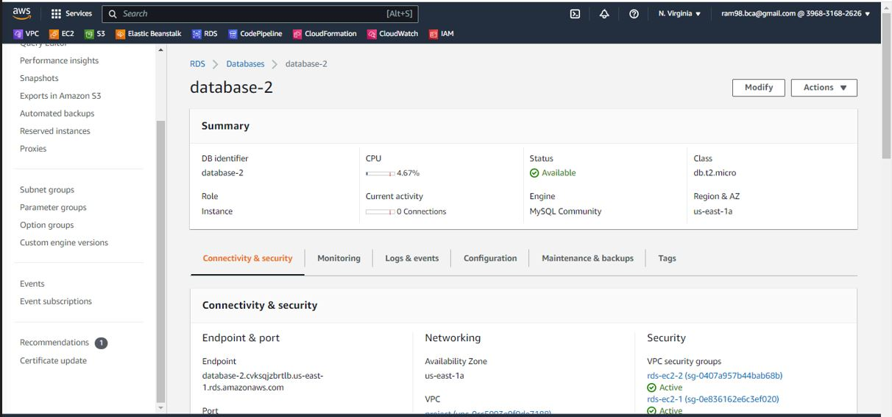
RDS Attached

Slide 26
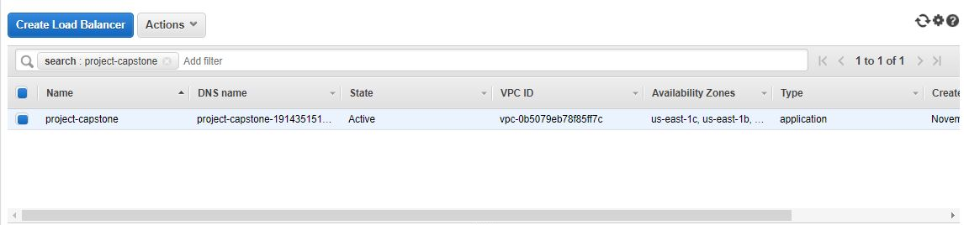
Target Group

Slide 27
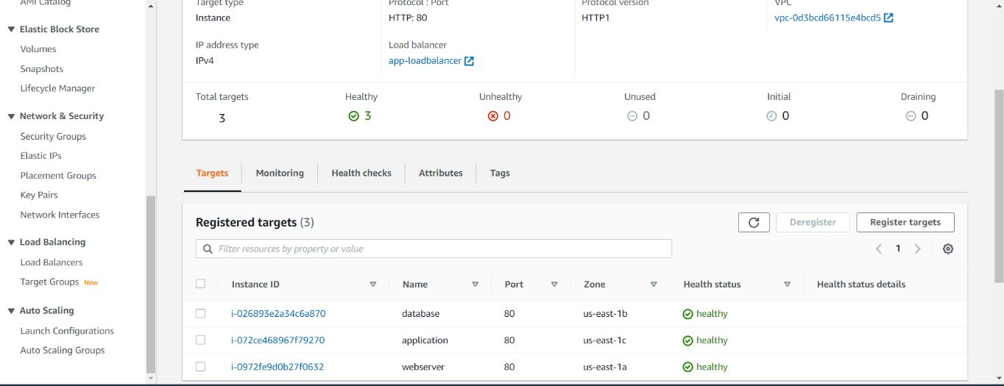
Load Balancer

Slide 28
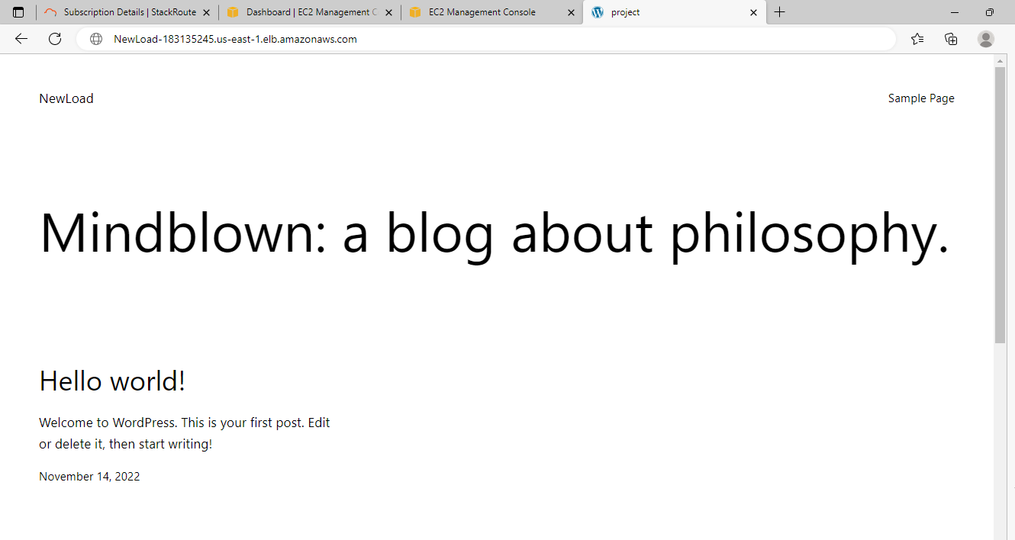
WordPress

Slide 29
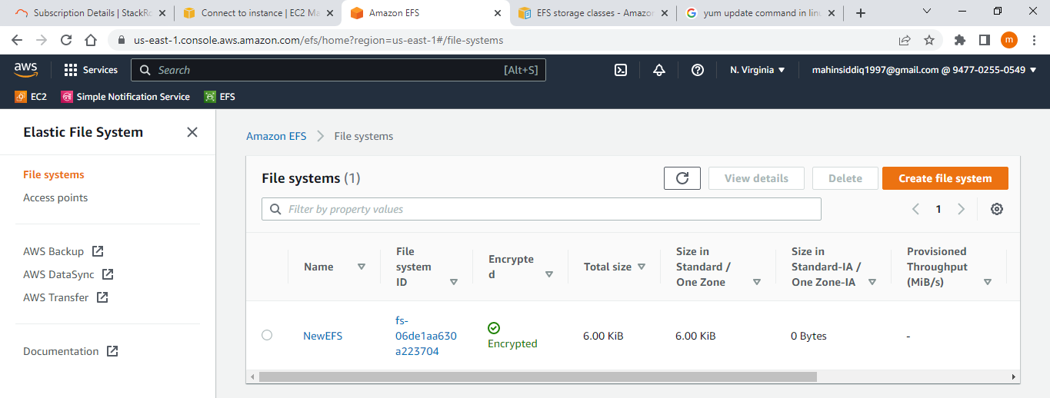
Creating EFS file system

Slide 30
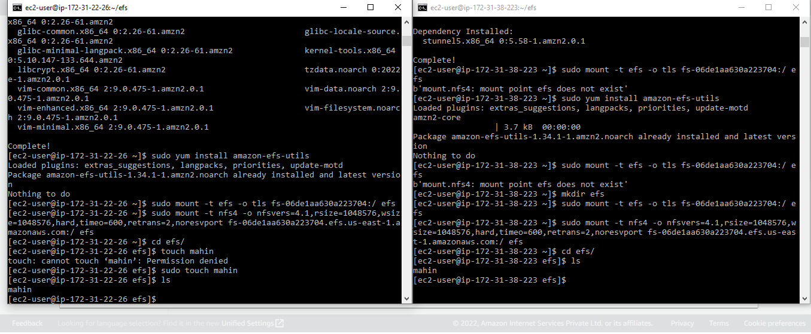
Mounted two Folders

Slide 31
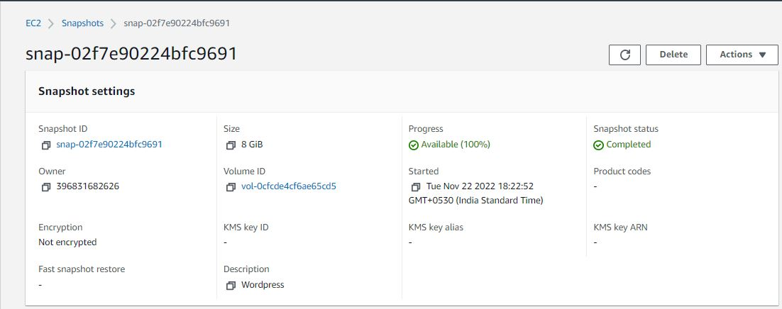
Snapshots

Slide 32
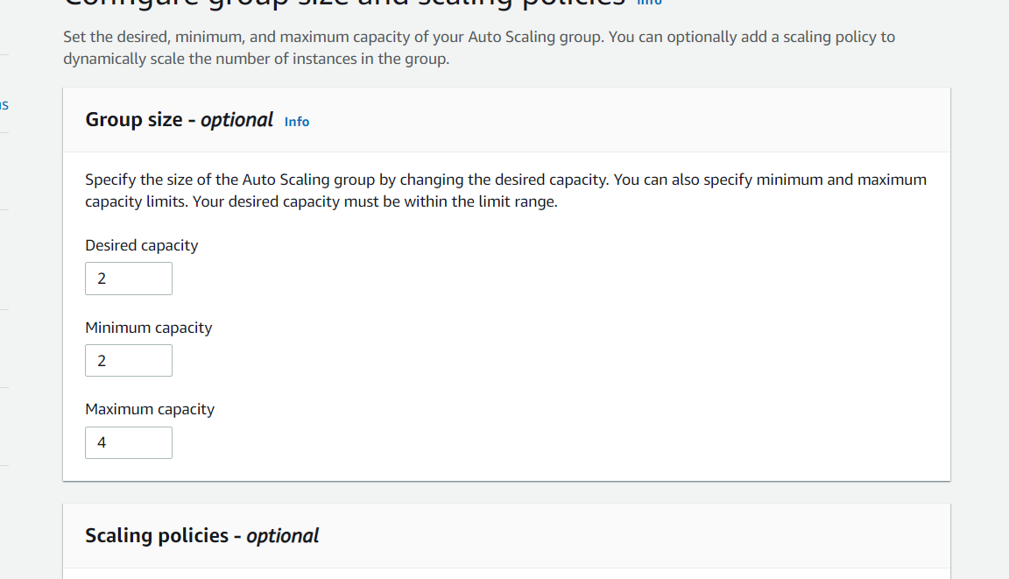
Auto Scaling

Slide 33
Implement Automation Using Ansible

Slide 34
Ansible Definition
Ansible is great choice for basic automation of system administration tasks.
Here we have used ansible to create Users and groups using playbooks. Jinja 2 templates (MOTD).

Slide 35
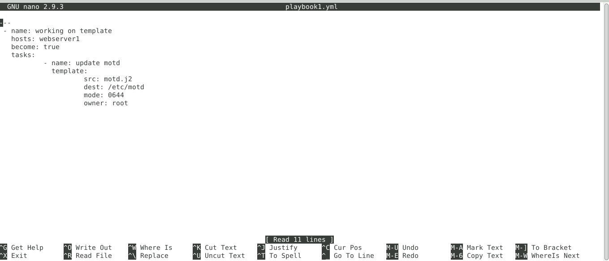
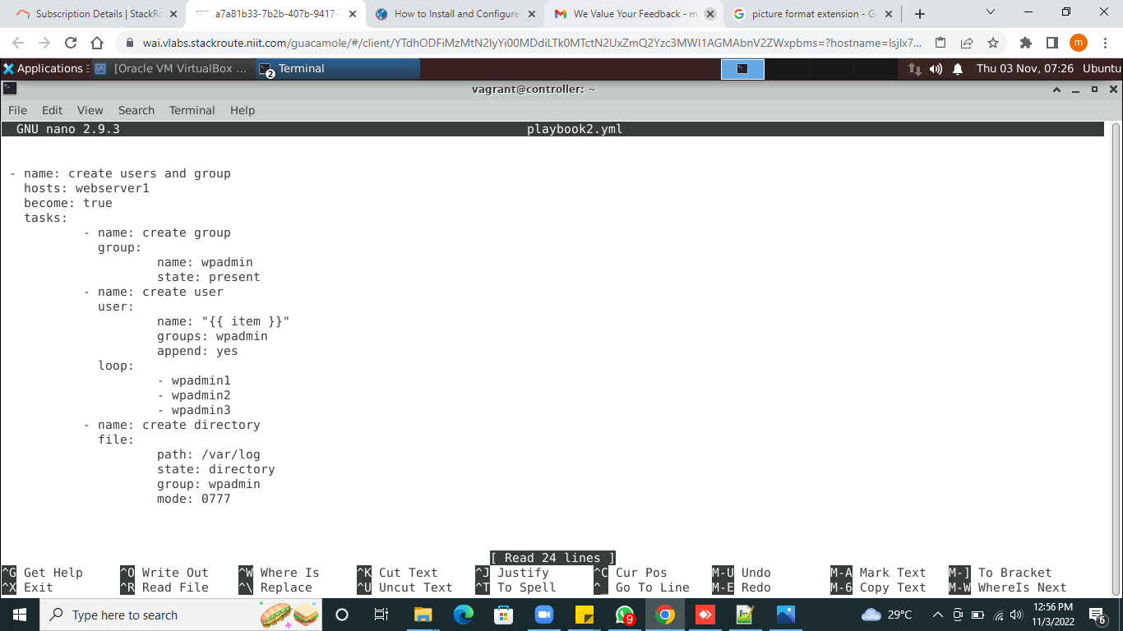
Playbooks1

Slide 36
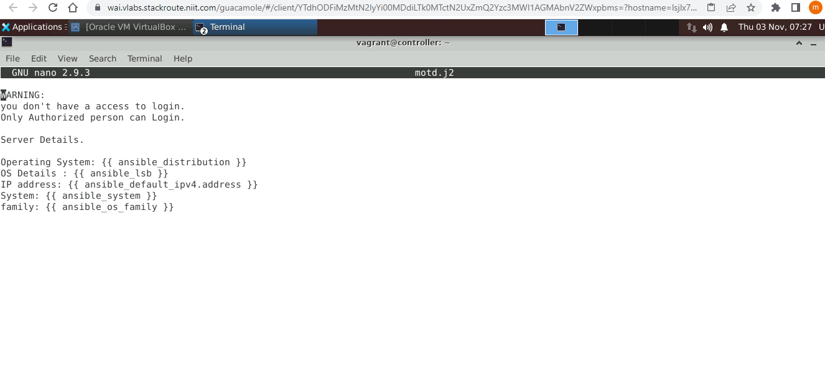
Motd.j2 Template

Slide 37
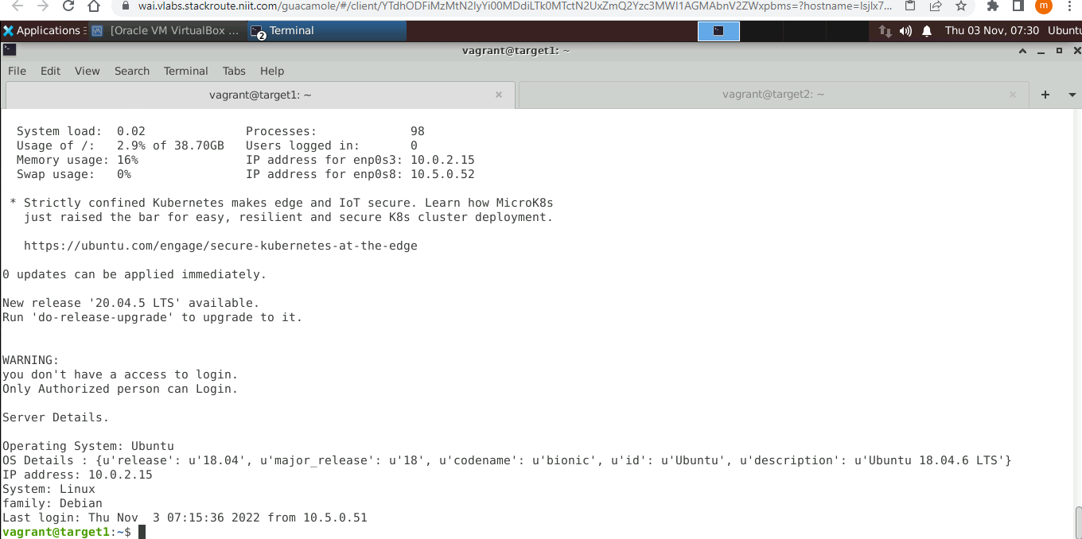
Message appear while login

Slide 38
Playbook2

Slide 39
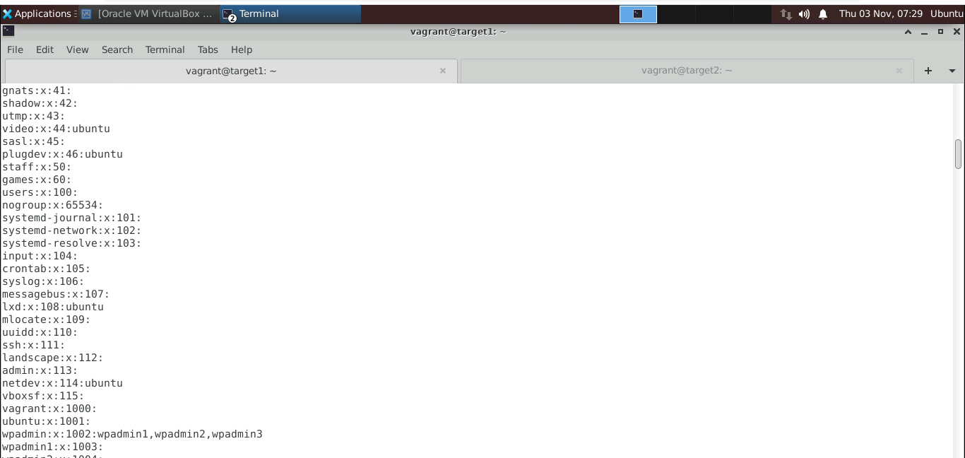
Permissions

Slide 40
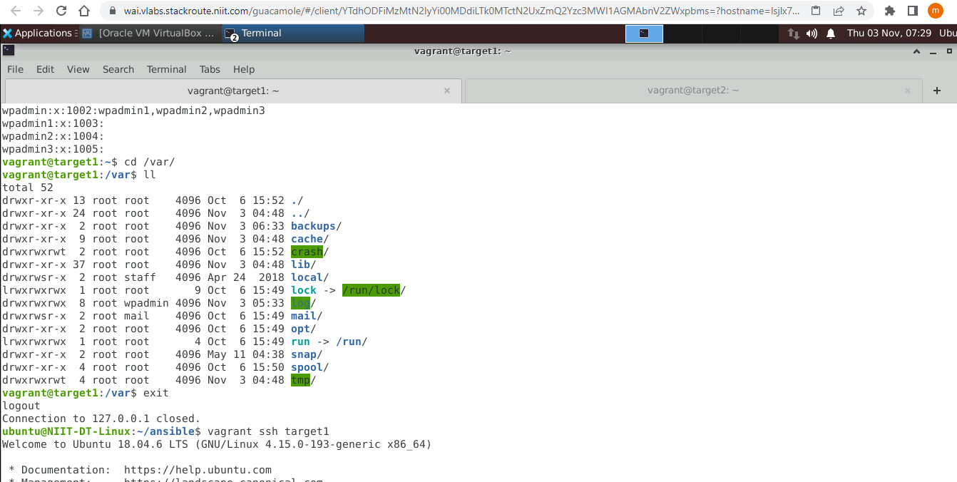
Available group

Slide 41
Implement Monitoring Solutions

Slide 42
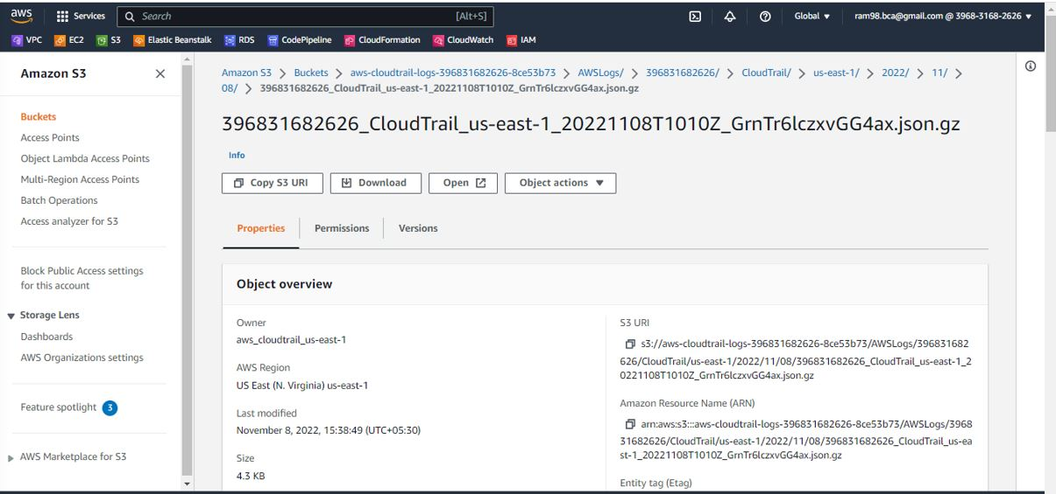
Cloud Trail

Slide 43
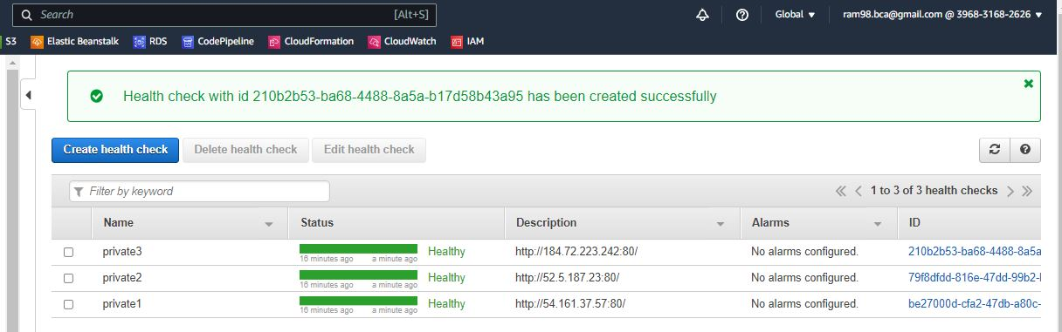
Route53

Slide 44
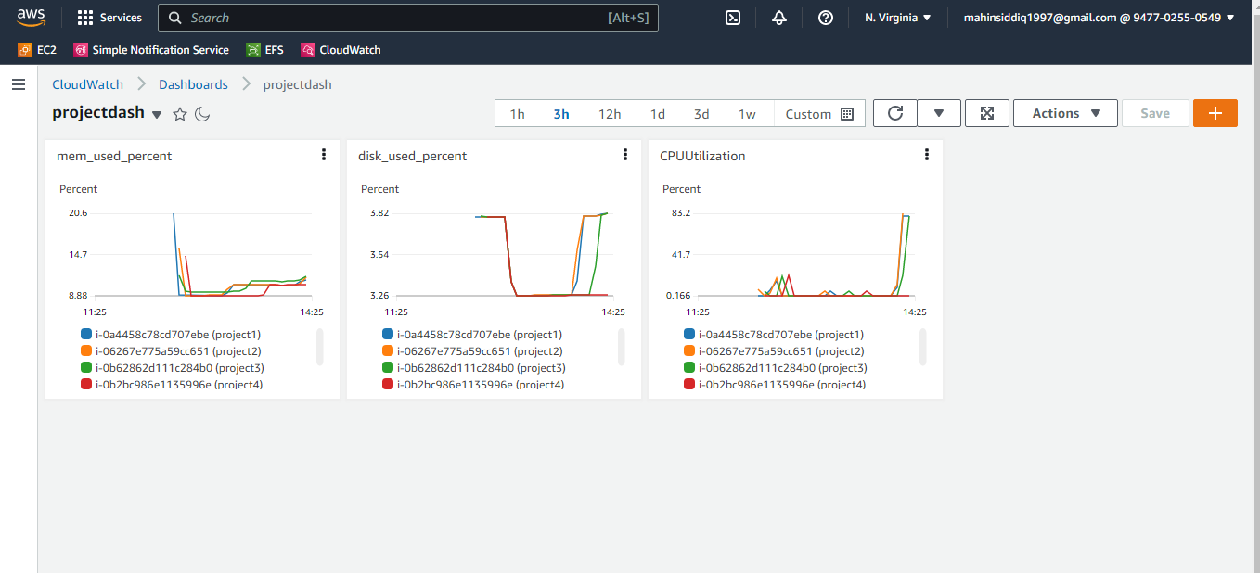
Cloudwatch Dashboard

Slide 45
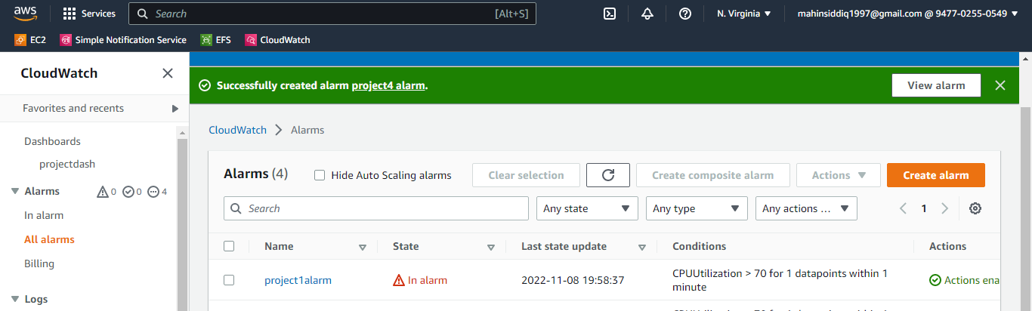
Alarm for CPU utilization

Slide 46
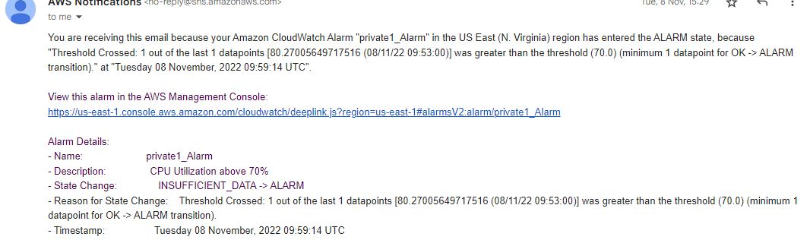
Gmail Alarm

Slide 47
CHALLENGE FACED
Configuring WordPress was quite difficult.
Creating a design of the project is taking more time for me

Slide 48
Thank You

